Slide 1
Weather Forecasting Website
Guided by:-
Prof. Riya Parmar
Prepared by:-
Henil Kevadiya (19BEIT30022)
Vivek Modi (19BEIT30072)

Slide 2
Contents
Abstract
System Definition
Advantages of System
Design Constraints
UML Diagram
Use Case Diagram
Sequence Diagram
Activity Diagram
Class Diagram
Data Flow Diagram
Screenshot of System

Slide 3
Abstract
Weather forecasting is the application of science and technology to predict the state of the atmosphere for a given location.
Ancient weather forecasting methods usually relied on observed patterns of events, also termed pattern recognition. For example, it might be observed that if the sunset was particularly red, the following day often brought fair weather.
Here this system will predict weather based on parameters such as temperature, humidity and wind. User will enter current temperature; humidity and wind, System will take this parameter and will predict weather (rainfall in inches) from previous data in database(dataset).
This system can be used in Air Traffic, Marine, Agriculture, Forestry, Military, and Navy etc.

Slide 4
System Definition
Weather forecasting is the application of science and technology to predict the conditions of the atmosphere for a given location and time.
The Central Objective of this system is to provide the prediction of atmospheric behaviour for a given location and time.
This system give accurate data as compare to ancient way.

Slide 5
Advantages of System
Military personnel benefit from weather forecasting as they can plan their military activities based on expected weather conditions. During the war the military can plan their battles by featuring in the expected weather condition to maximize the chance of winning the war.
Weather forecasting enable people to plan and take precautions against various natural calamities such as flood and typhoon so that to minimize their effects.
Weather forecasting enables farmers to adjust their farming activities to suit the expected weather condition. For example, if it is expected that there will be less rainfall in the future then farmers will prepare an irrigation system to compensate for the shortfall.
Weather forecasting greatly influences transport, especially in air and water.

Slide 6
Design Constraints
1. Software Constraints
Operating System – Windows/linux
HTML
CSS
JavaScript
2. Hardware Constraints
Processor – INTEL CORE i3(2.30 GHz)
RAM – 4 GB RAM
Hard disk – 250 GB HDD
Laptop

Slide 7
UML Diagrams
The unified modelling language (UML) is a standard language for specifying, visualizing, constructing, and documenting the artifacts of software systems, as well as for business modeling and other non-software systems
The UML uses graphical notations to express the design of software projects

Slide 8
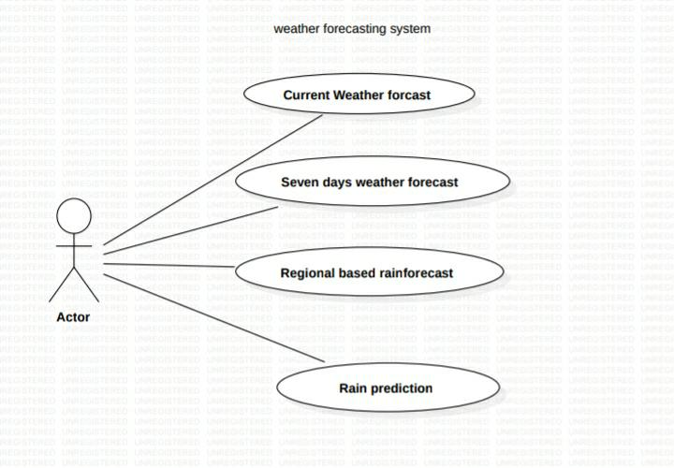
Use Case Diagram

Slide 9
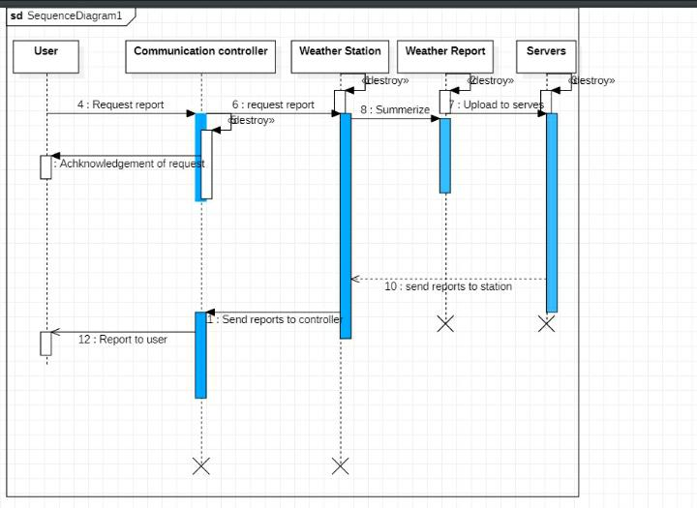
Sequence Diagram

Slide 10
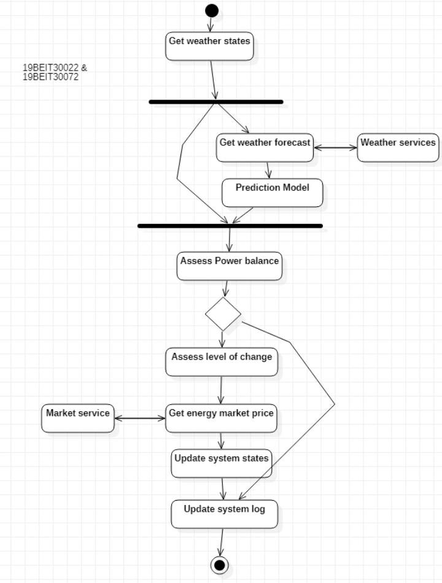
Activity Diagram

Slide 11
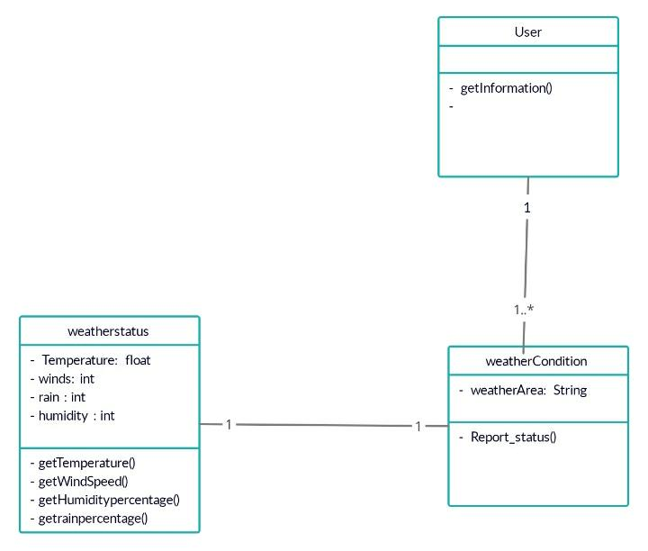
Class Diagram

Slide 12
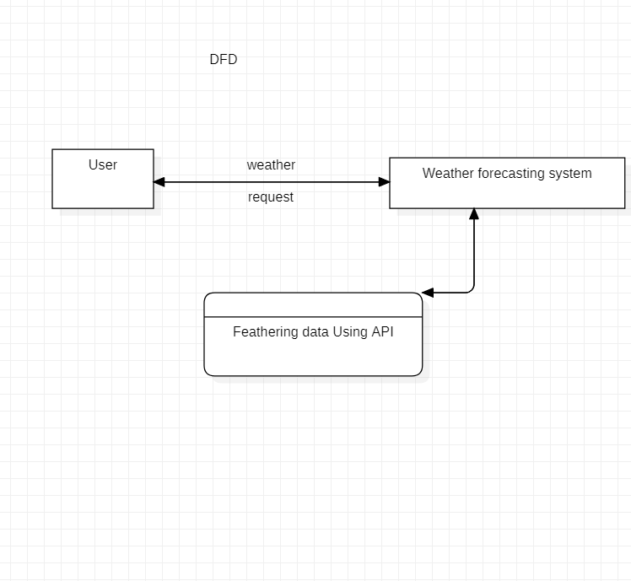
DFD

Slide 13
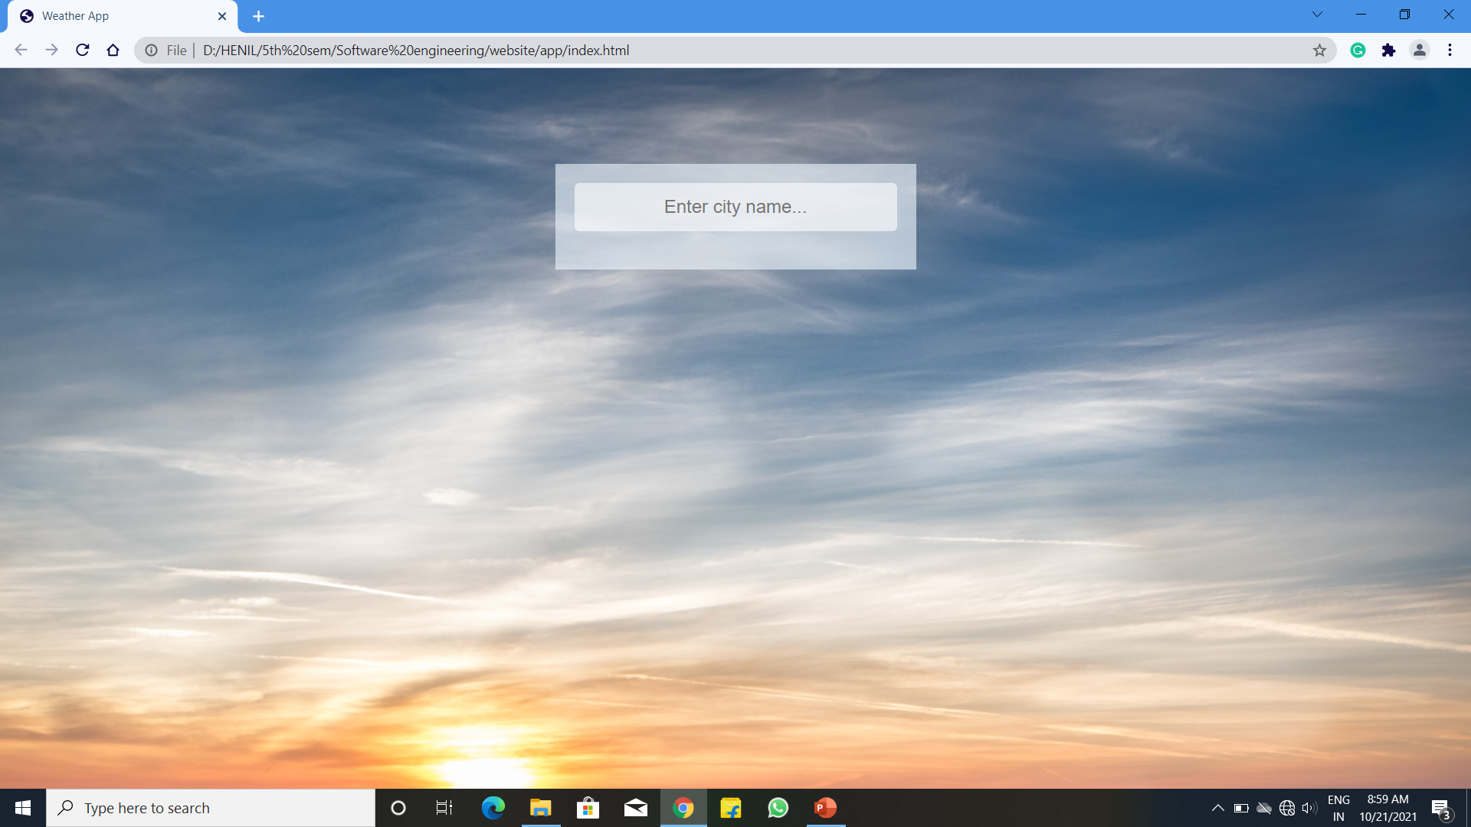
Screenshot of system

Slide 14
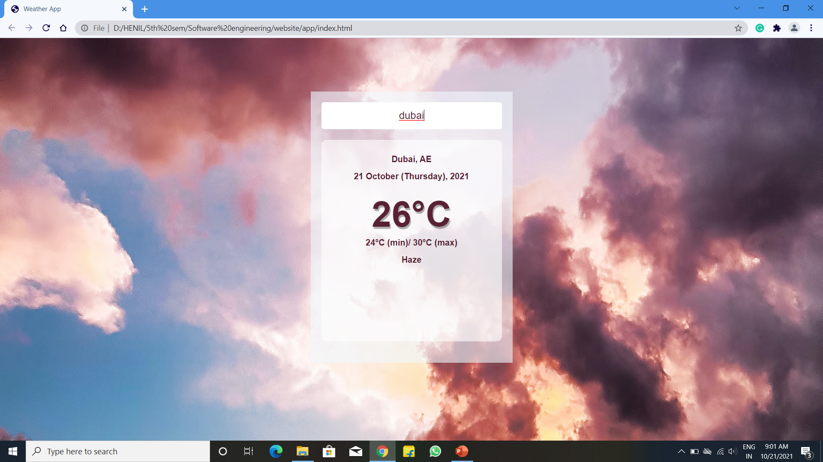
Screenshot of system

Slide 15
Thank You

